Slide 1
CAPSTONE 1
big_mountain
BIG MOUNTAIN RESORT

Slide 2
Problem identification
Big Mountain Resort spent $1,540,000 on additional chair lift to help increase the yearly distribution of visitors across mountain.
How can they recover this cost?
Charge above average price?
Select best values for ticket price?
The goal is to be able to recover cost and still able to capitalize on its facilities.

Slide 3
Problem identification
Criteria for success
Selecting better value for ticket price by also putting resort’s facilities into consideration.
Cut some less-important costs without undermining the ticket price
Scope of solution space
Ticket pricing will be reviewed.
Cost of operations will be re-evaluated.
Some irrelevant costs will be dropped.

Slide 4
Problem identification
Constraints within solution space
All operations might be relevant and perhaps difficult to manipulate their cost of operation.
Less operational costs might lead to decrease in visitors.

Slide 5
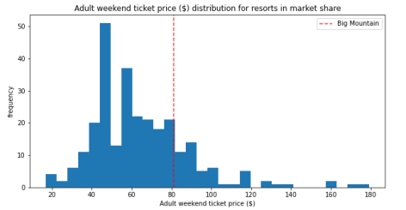
Recommendation and key findings
Findings
Big mountain amongst all resorts for price.
Obvious that Big Mountain is currently undercharging.

Slide 6
Recommendation and key findings
Recommendation
Decided on which features are most important.
Close down up to 10 of the least used runs since it doesn't impact any other resort statistics.
Add 2 acres of snow making cover

Slide 7
Modeling results and analysis
The model says closing one run makes no difference.
Closing 2 and 3 successively reduces support for ticket price and revenue.
If Big Mountain closes down 3 runs, it seems they may as well close down 4 or 5 as there's no further loss in ticket price.
Increasing the closures down to 6 or more leads to a large drop.

Slide 8
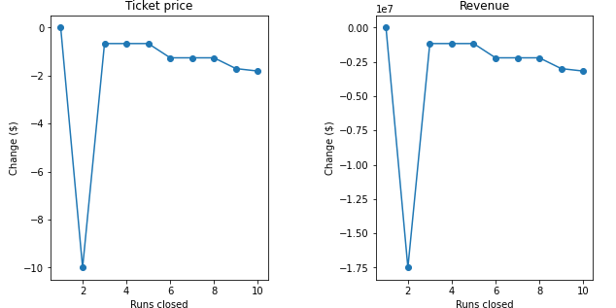
Modeling results and analysis

Slide 9
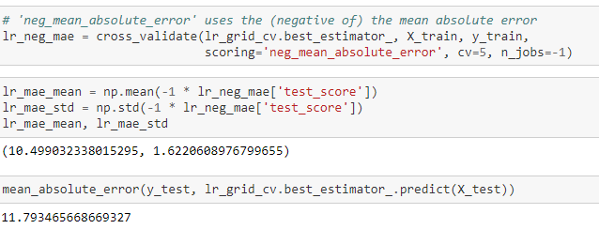
Modeling results and analysis
Model performance
Linear regression

Slide 10
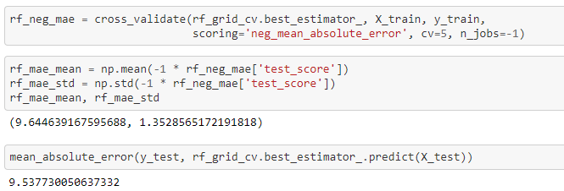
Modeling results and analysis
Model performance
Random Forest

Slide 11
Summary and conclusion
The random forest model has a lower cross-validation mean absolute error by almost $1. It also exhibits less variability.
Verifying performance on the test set produces performance consistent with the cross-validation results.
Since random forest performs better, it will be the best model to go with.

